Slide 1
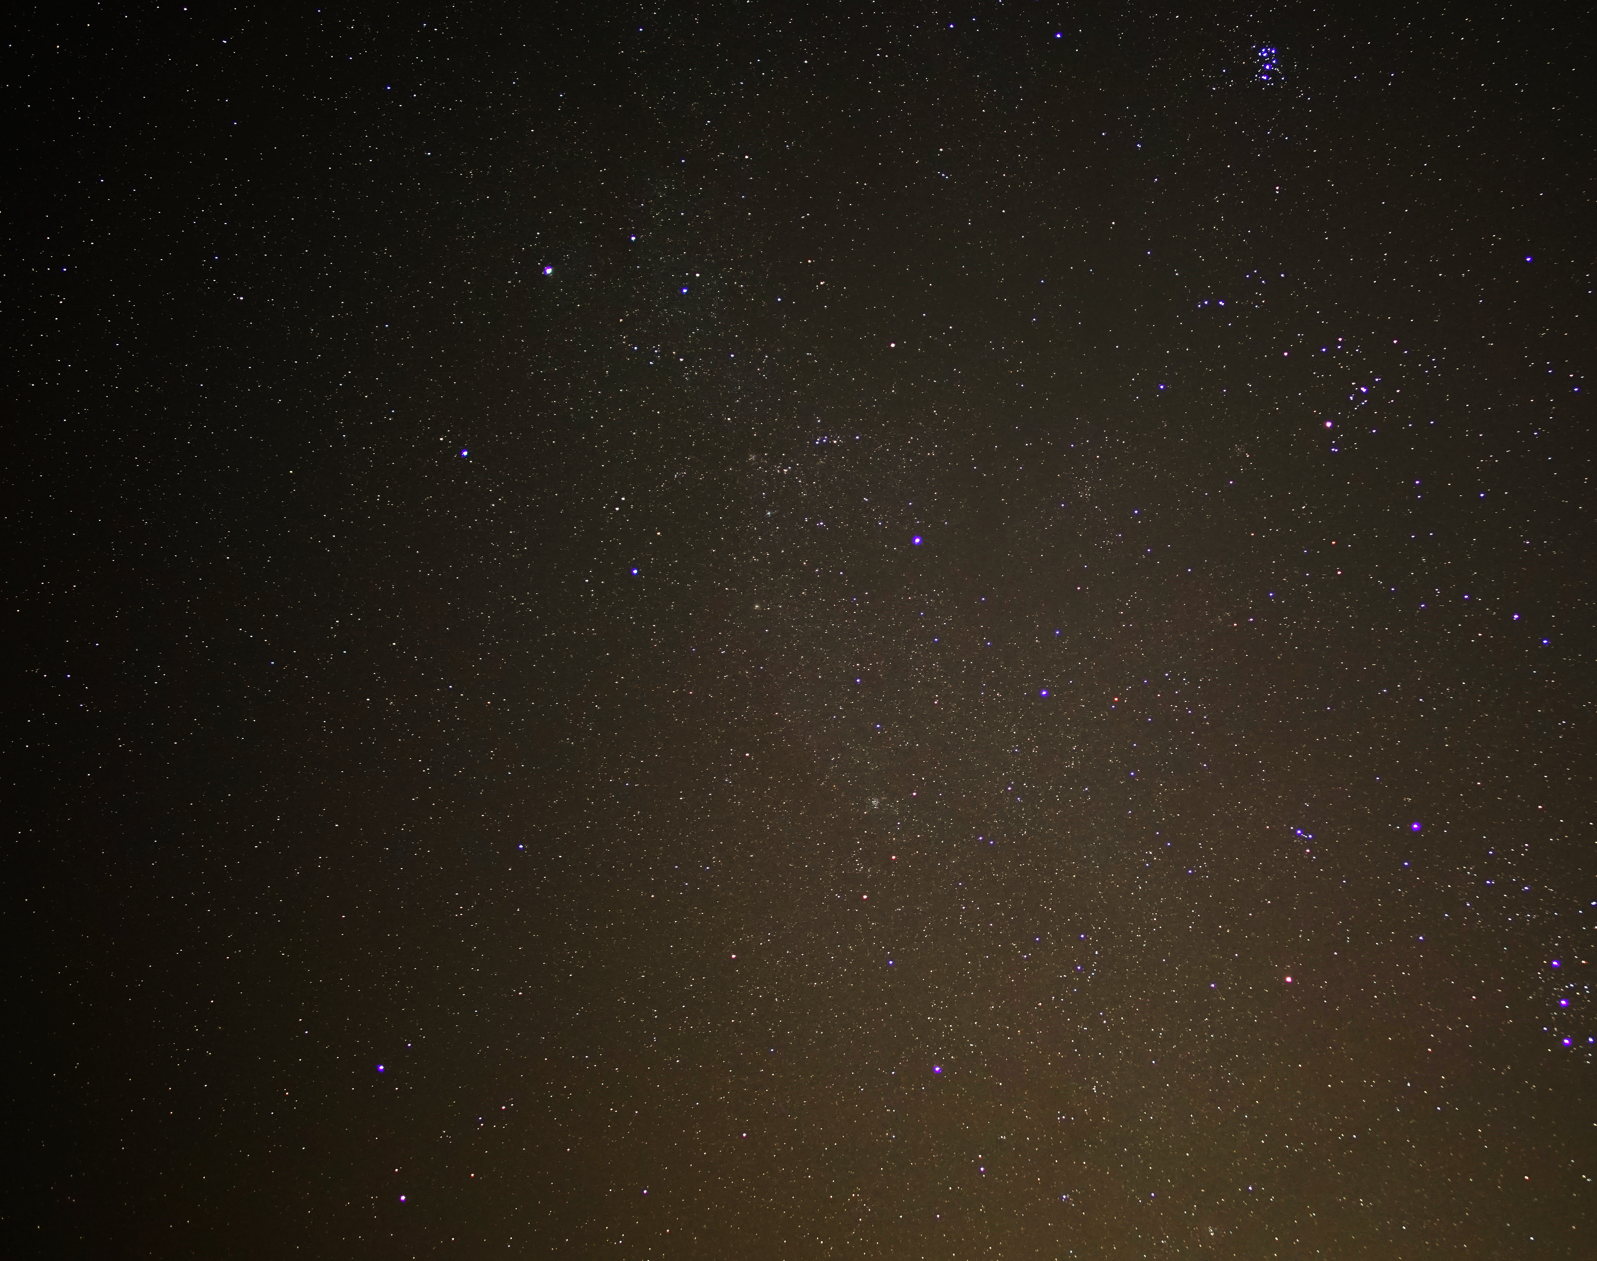
Astronomy 100 Lab 6
COVID REMINDERS: Your face mask must cover your mouth AND nose.
If you are feeling at all ill, email your instructor, and don’t come to lab unless you have gotten a negative test.
Pleiades cluster
Fall 2021
Yvonne Ban
Amherst, MA
18 Oct 2020

Slide 2
Please take the Pre-lab 6 Survey in Moodle
Don’t forget to watch for opportunities to get a second sunset picture!
The goal is to get 3 good sunset pictures spanning at least 4 weeks and separated by at least 1 week from each other.

Slide 3
Magnitudes… Confusing? Absolutely!
–15 | –10 | –5 | 0 | +5 | +10 | +15 | +20
Full Moon | Venus at brightest | brightest stars | faintest by eye | faintest in binoculars | faintest in small telescope
How bright something looks to us (on Earth) is called its apparent (or visual) magnitude.
The system goes back to ancient times, when the brightest stars were called 1st magnitude and the dimmest visible to the unaided eye were 6th magnitude (100 × dimmer).
Like many human perceptions, it’s a logarithmic scale.
Today astronomers have extended the scale so really bright things have negative magnitudes!
To compare stars on an equal footing, we use absolute magnitude, which gives the apparent magnitude they would have if the were 10 parsecs (about 32 light-years) distant. It’s a measure of luminosity (total # of watts).

Slide 4

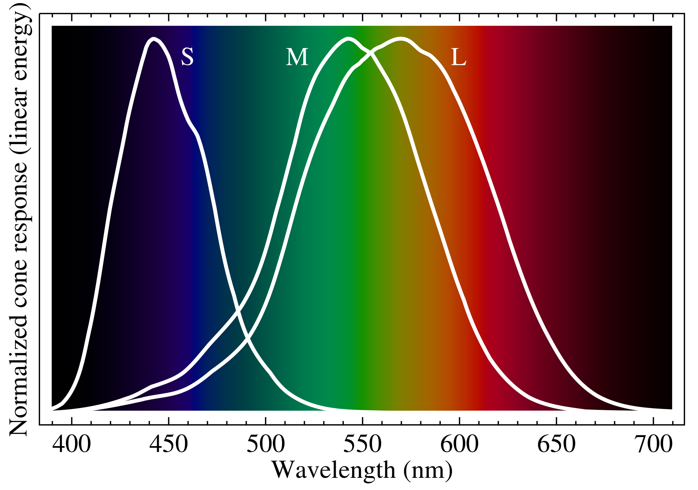


Colour index: B$−$V
similar to
similar to
B
V
Humans see 3 different colours: blue, green, and red
Similarly, we can use filters to determine the color of stars by looking at the difference in their magnitude at different wavelengths:
$$m\left(B\right)−m\left(V\right)=B−V$$
$m$ is the intensity of the star measured in each filter
B = blue, V = visual (green)
B-V lower ➔ bluer ➔ hotter
B-V higher ➔ redder ➔ cooler
↓
↓

Slide 5
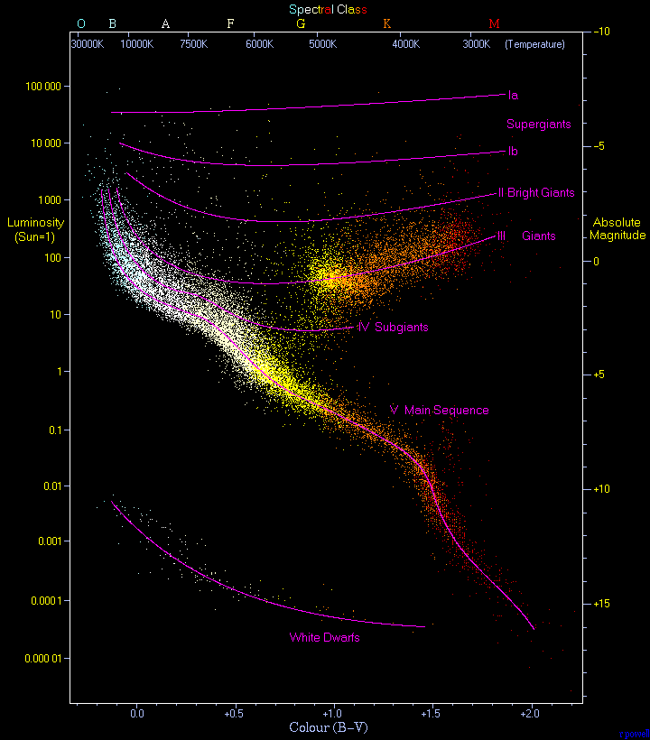
Hertzsprung-Russell diagram
Not HaRd to understand: https://sci.esa.int/gaia-stellar-family-portrait/
Absolute magnitude is related to luminosity
B-V is related to temperature
Temperature runs backwards plotted this way!
Hot ← ← ← Cold

Slide 6
Part 1: Stellar properties
In groups of up to 3, open up Stellarium and turn off atmosphere (A) and ground (G) visualization.
Find the star Procyon. From the information panel, find:
Absolute magnitude
Color index (B-V)
Distance
Spectral type
It’s a lot easier to find this info in Stellarium if you Configure (F2) the Information to show just what you need!
(If you use the web app, you will need to look up Procyon on Wikipedia and look in the information panel on the right side of its page.)

Slide 7
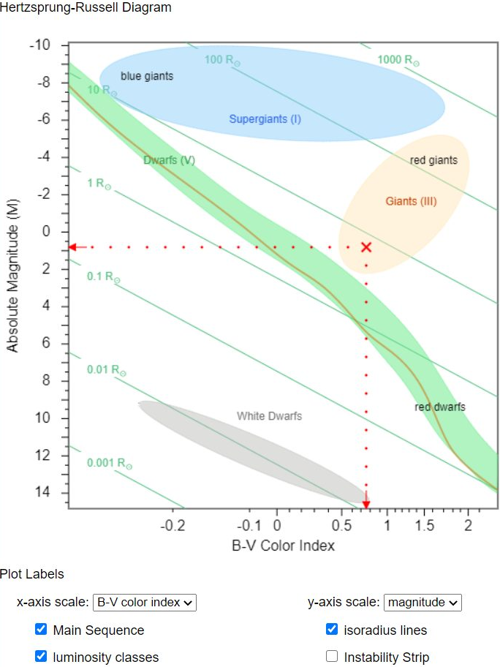
Part 2: Stellar size
Go to this website: http://astronomy.nmsu.edu/geas/labs/hrde/hrd_explorer.html
Under Plot Labels:
Set the x-axis scale to “B-V color index”
Set the y-axis scale to “magnitude”
Click on the HR diagram where Procyon is located by its absolute magnitude and B-V value. (You can fine-tune the values using the sliders on the left.)
The app will find for Procyon:
Temperature (in Kelvin)
Luminosity (in solar luminosities)
Size (in solar radii)
Turn on the Main sequence and luminosity classes by clicking them.
Estimate where Procyon is located closest to: Main Sequence line (MS), red giants (RG), supergiants (SG), or white dwarfs (WD).

Slide 8
Part 3: Starry-eyed
Return to Stellarium and turn on constellation labels and boundaries.
In your assigned constellation, find the bright stars and their properties (for the web app, use Wikipedia):
Time to draw on your art talents! On the board, draw circles representing your closest and furthest stars where:
the diameter corresponds to its size (1 cm for the Sun)
the colour corresponds to its spectral type:
they are labelled with their name and spectral type.
Name | Abs. Mag | B-V | Distance (ly) | Spectral type | Temperature (K) | Luminosity (solar) | Size (solar) | HRD location
O or B | A | F | G | K | M
Violet | Blue | Green | Yellow | Orange | Red

Slide 9
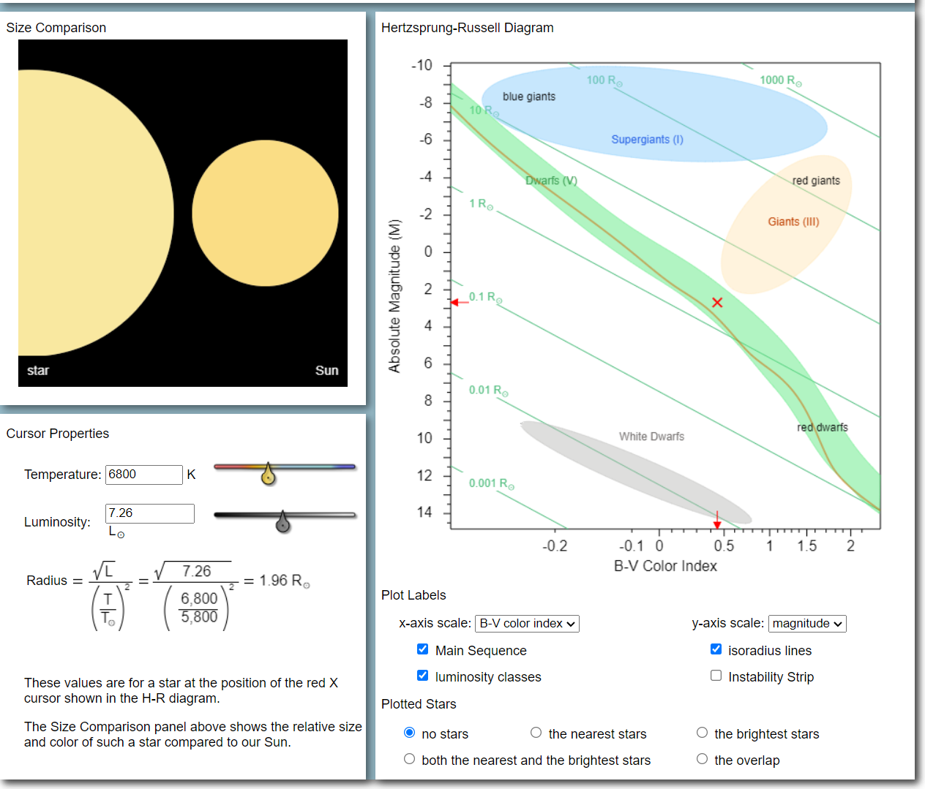
Example: Procyon

Slide 10
Constellation assignments
Table No. | Constellation | Table No. | Constellation
1 | Boötes | 7 | Orion
2 | Canis Major | 8 | Sagittarius
3 | Cassiopeia | 9 | Scorpius
4 | Centaurus | 10 | Ursa Minor
5 | Cygnus | 11 | Virgo
6 | Lyra

Slide 11
Part 4: Near, far, wherever you star
Go to the Wikipedia page “List of stars in [your constellation]”.
Sort by distance by clicking the up/down arrows in the Distance column.
Each person picks a different nearest star and finds its properties.
On the HR Diagram Explorer page, change the X-Axis Scale to “Spectral type”.
Copy your answers into the Table Worksheet and compare them.
Think about the following questions. We’ll discuss these at the end of lab:
On the “List of stars” webpage, click on “the nearest stars” and “the brightest stars.” Why do these look so different?
How do the stars you can see by eye at night compare to the Sun?
How do the nearby stars compare to the Sun?
Is the Sun a “typical” star?

Slide 12
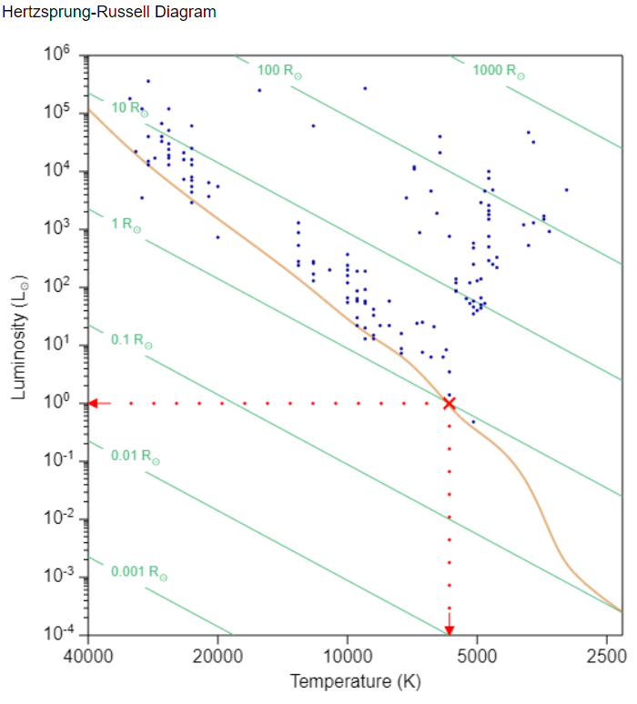
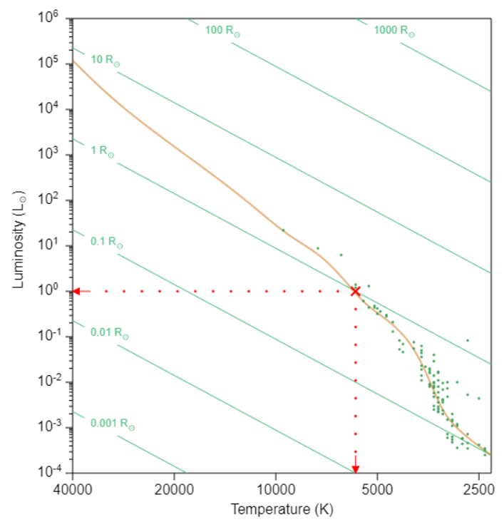
Part 4: Near, far, wherever you star
BRIGHTEST
NEAREST
d. Is the Sun a “typical” star?

Slide 13
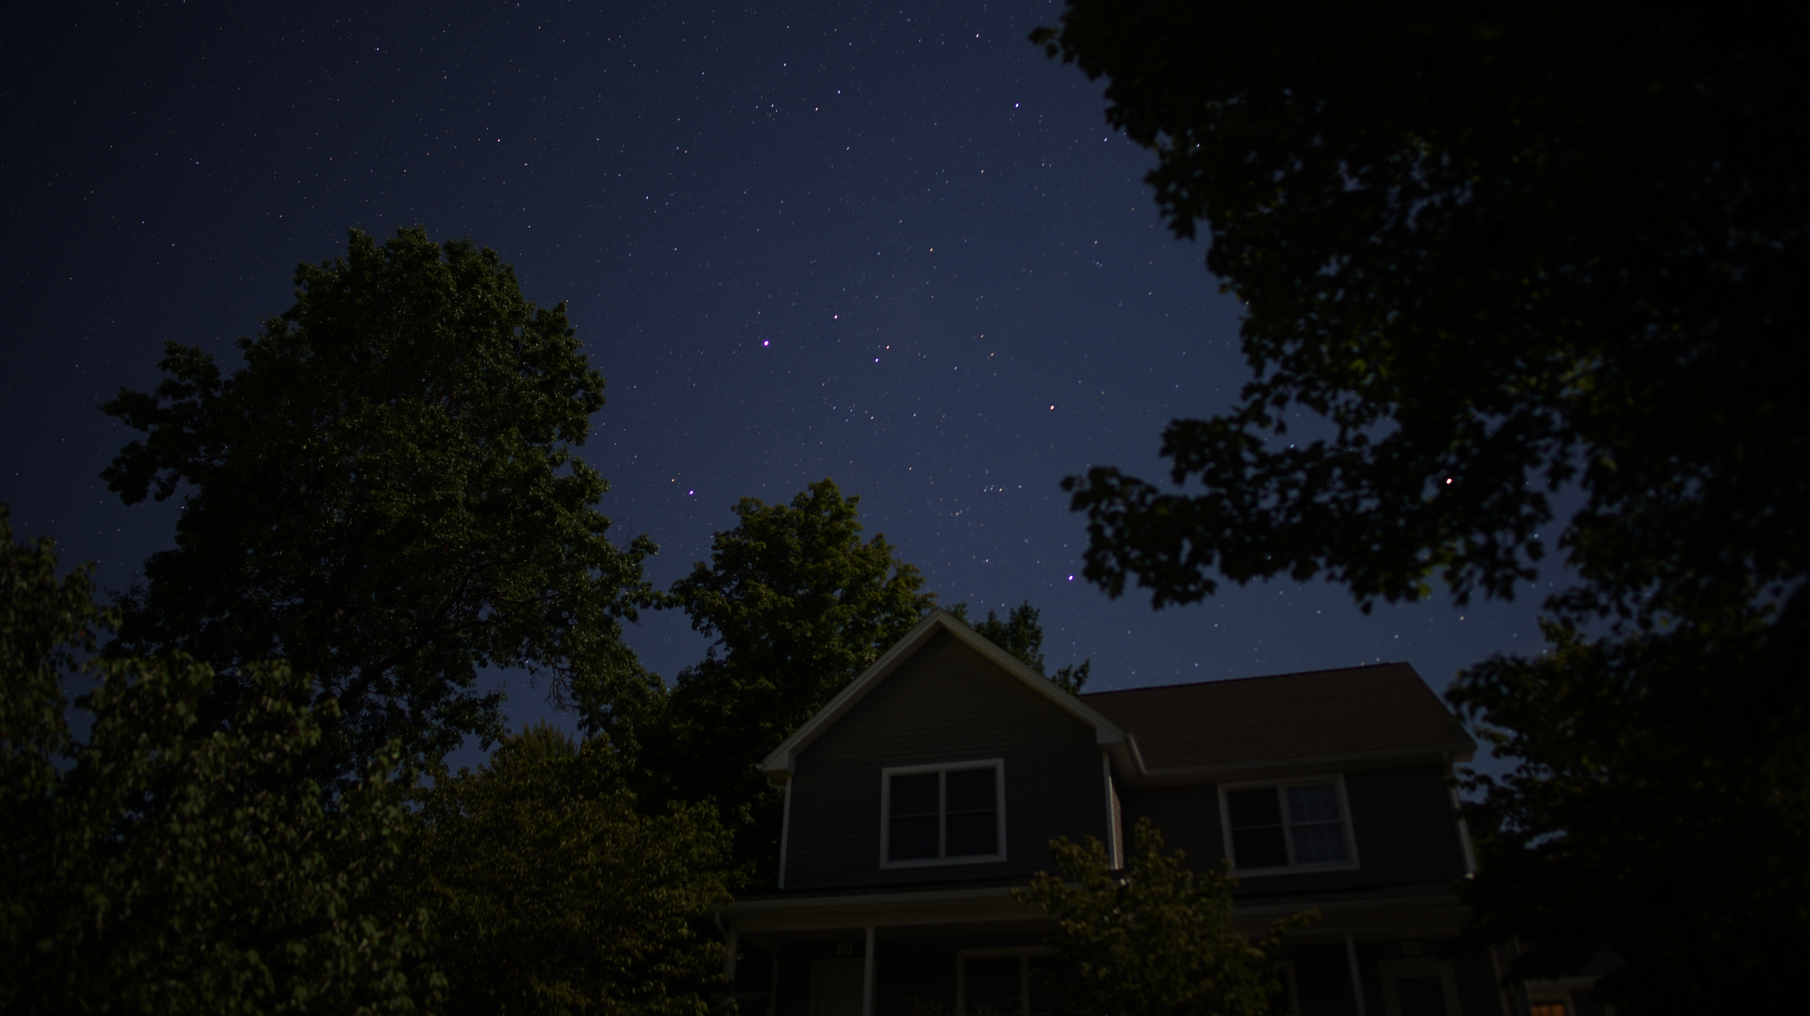
Fill in the Lab 6 end-of-lab quiz on Moodle.
Make sure to write your name on the Table Worksheet and turn it in!
Yvonne Ban
Amherst, MA
5 Sept 2020

